Slide 1
CS 111 Discussion - 2
Gayathri Muralidharan

Slide 2
Project Lab1A
Today we will be covering these parts:
Functions required for project
Character-at-a-time, full duplex terminal I/O
Passing input and output between two processes
Shutdown processing
Error checking

Slide 3
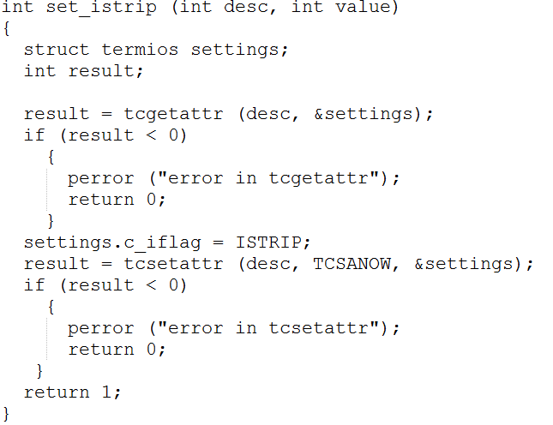
Functions required for project
termios(3), tcgetattr(3), tcsetattr(3)

Slide 4
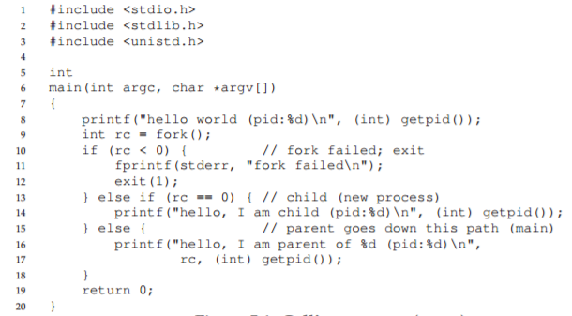
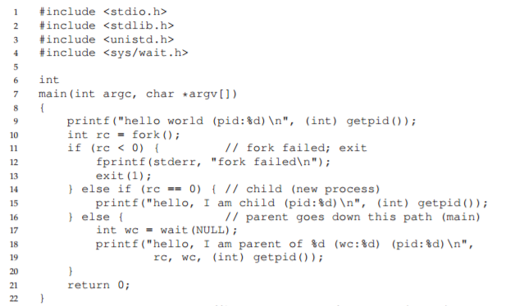
fork()

Slide 5
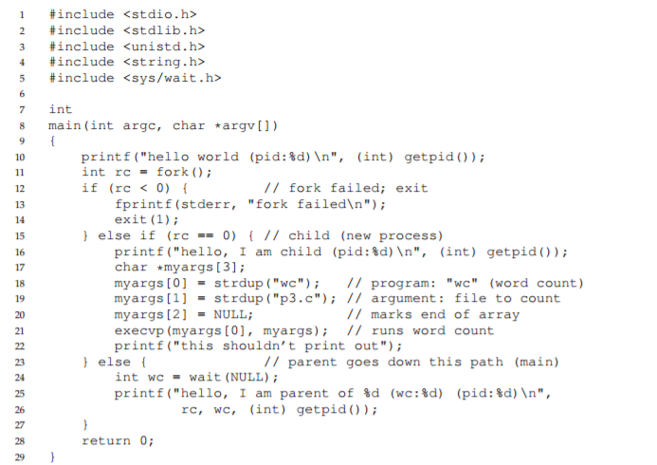
Waitpid()
waitpid(childID, &status, WNOHANG|WUNTRACED);
Exec()

Slide 6
pipe(2):
int pipe (int filedes[2]);
The pipe function creates a pipe and puts the file descriptors for the reading and writing ends of the pipe (respectively) into filedes[0] and filedes[1].
An easy way to remember that the input end comes first is that file descriptor 0 is standard input, and file descriptor 1 is standard output.
Kill:
int kill(pid_t pid, int sig);
The kill() function shall send a signal to a process or a group of processes specified by pid. The signal to be sent is specified by sig.

Slide 7
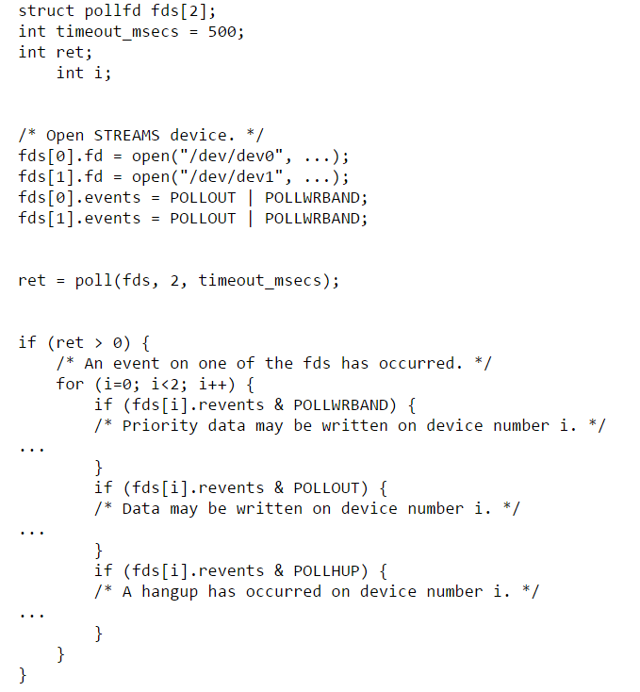
Poll():

Slide 8
Character-at-a-time, full duplex terminal I/O
c_iflag = ISTRIP; /* only lower 7 bits */
c_oflag = 0; /* no processing */
c_lflag = 0; /* no processing */
Steps:
Set the mode as above.
Whatever input is read, we need to process the input. Handle the ‘/n’, ‘/r’ and EOF.
When exiting, restore the settings and exit.

Slide 9
Case ‘0x03’:
…….
Case ‘0x04’:
Call kill() here.
……..
Case ‘\r’:
……..
Case ‘\n’:
……….

Slide 10
Passing input and output between 2 processes
Use fork() to create a new process.
Create two pipes.
In the child process, call exec() to execute the shell command.
In the main process, using poll(), enable communication between console and process.

Slide 11
struct pollfd fds[1]; fds[0].fd = /*fd of the read end of the pipe*/ fds[0].events = /*specify events*/
for(;;) { int value = poll(pollfds, 2, 0); if (fds[0].revents & POLLIN) { */ read here */
} if (fds[0].revents & (POLLHUP+POLLERR)) { fprintf(stderr, “error in shell"); break; } } }

